Slide 1
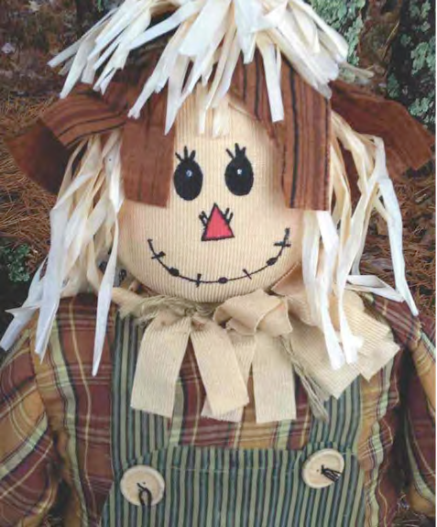

1/1/2014
Neuroscience in the Classroom©
Lou Whitaker, Ed. D.
Open Minds Enterprises
“…unlocking unlimited potential”™
“If I Only Had a Brain….
I could use my Senses to Learn!”
Preschool, Kindergarten and 1st Grades

Slide 2


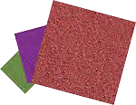

Using your senses ….
Touch
Is it rough or soft?
Can you tell me with your eyes closed?
Soft Pillow
Sandpaper
Pixabay (2013). Sandpaper Grit Grinding Green Paper Pattern. Retrieved November 12, 2013, from http://pixabay.com/en/sandpaper-grit-grinding-green-153235/ Pixabay (2013). Red Blue Yellow Cartoon Bed Free Pillows Sleep. Retrieved November 12, 2013, from http://pixabay.com/en/red-blue-yellow-cartoon-bed-free-29866/ Pixabay (2013). Red Outline Star Silhouette Cartoon Fish Free. Retrieved November 12, 2013, from http://pixabay.com/en/red-outline-star-silhouette-32938/

Slide 3
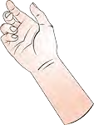
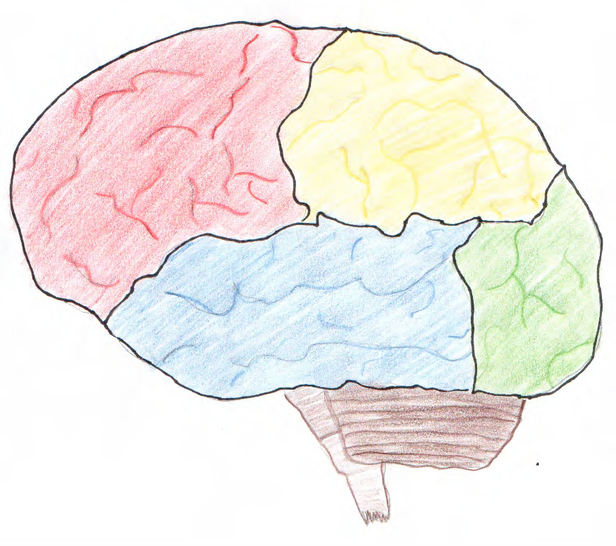







Touch
Pixabay (2013). Point Hand Figure Cartoon Thumb Nail Finger. Retrieved November 12, 2013, from http://pixabay.com/en/point-hand-figure-cartoon-thumb-41386/
Pixabay (2013). Sandpaper Grit Grinding Green Paper Pattern. Retrieved November 12, 2013, from http://pixabay.com/en/sandpaper-grit-grinding-green-153235/ Pixabay (2013). Red Blue Yellow Cartoon Bed Free Pillows Sleep. Retrieved November 12, 2013, from http://pixabay.com/en/red-blue-yellow-cartoon-bed-free-29866/ Pixabay (2013). Red Outline Star Silhouette Cartoon Fish Free. Retrieved November 12, 2013, from http://pixabay.com/en/red-outline-star-silhouette-32938/

Slide 4


Listen …. What do you hear?
Soundbible.com (07/20/2010). Best Cardinal Bird Sound. Retrieved November 13, 2013, from http://soundbible.com/1515-Best-Cardinal-Bird.html
Hearing …..
Pixabay (2013). Tweet Twitter Bird Blue Twig Branch Green Hills. Retrieved November 12, 2013, from http://pixabay.com/en/tweet-twitter-bird-blue-twig-155281/

Slide 5
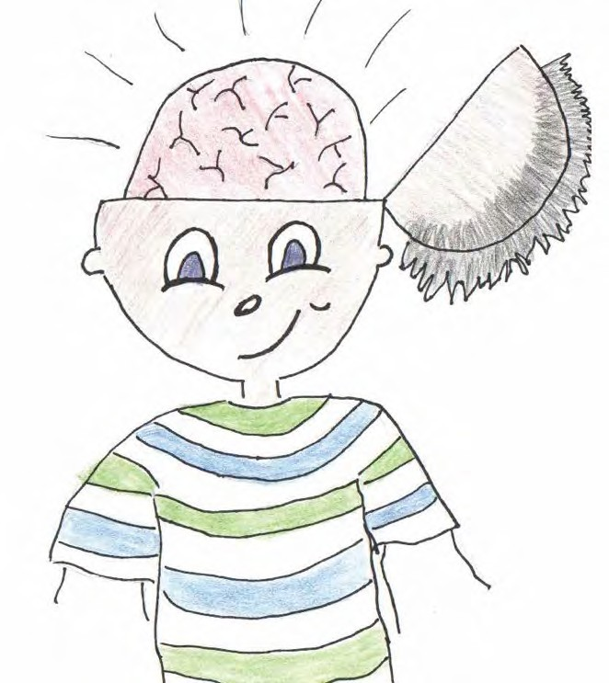
So what is Memory?
Memory is everything we know and have learned.
Informa9on comes in through our senses and is stored in our brain.
When we want to remember or recall something, the brain “turns on” or “lights up” and we remember.

Slide 6
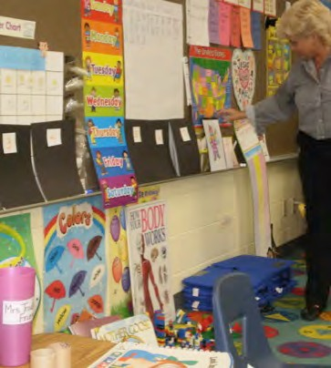
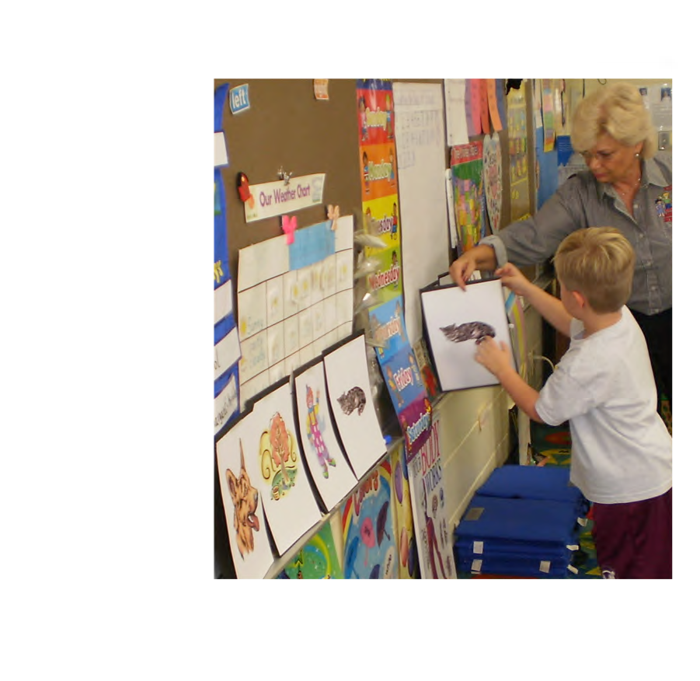
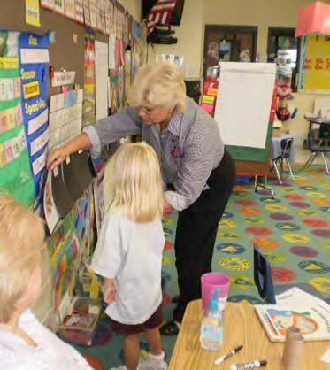
Let’s play a game to see how our memory works….
The Memory Game

Slide 7

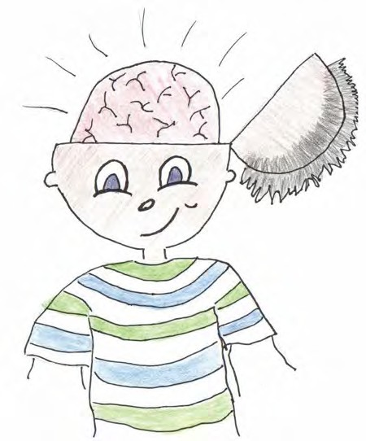
What if our brain
got sick?
How do we keep our brains healthy?
Is it important to keep our brains healthy and safe? Why?

Slide 8
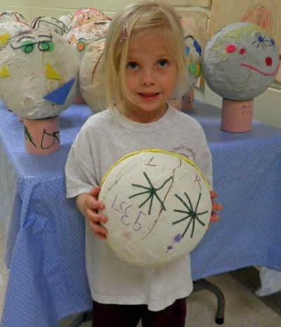
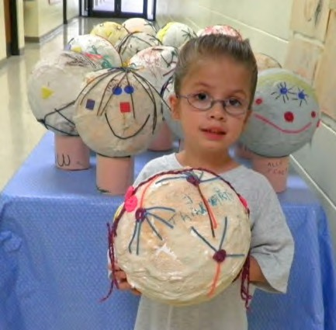
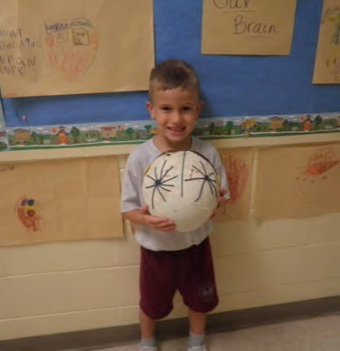
Is it important to learn about your brain? Why?

Slide 9
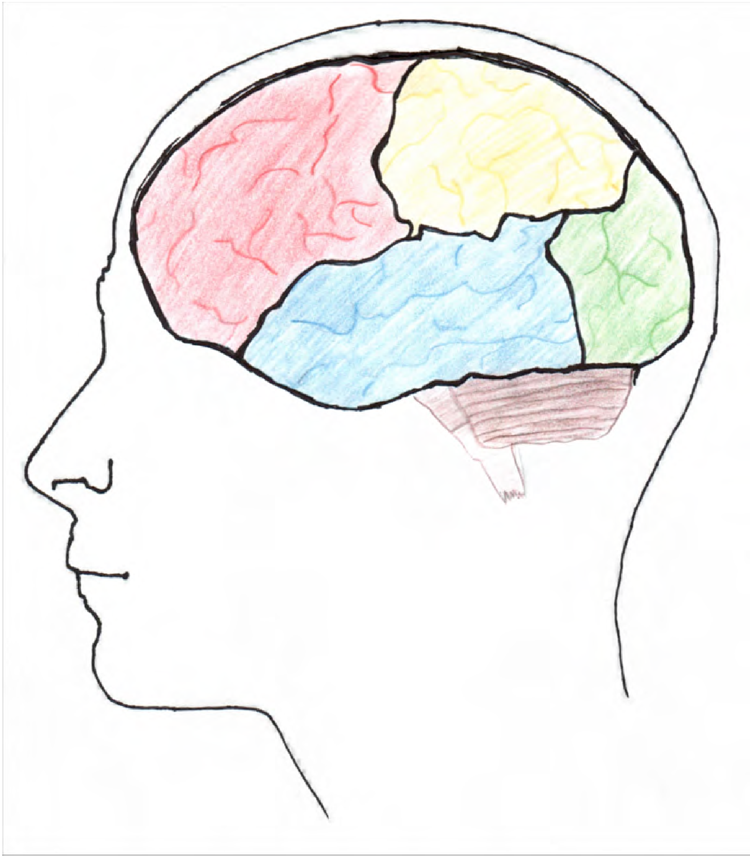
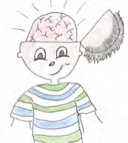
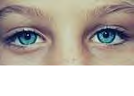
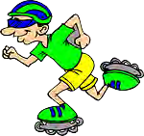
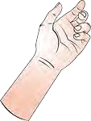
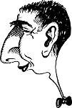

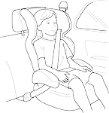


Homework ….
Mom and Dad, Let me teach you about my brain.
Smelling
Touching
Seeing
Hearing
Tasting

